Slide 1
Software Engineering
System Modeling

Slide 2
Topics covered
Context models
Interaction models
Structural models
Behavioral models
Model-driven engineering

Slide 3
Existing and planned system models
Model the existing system - clarify minimum needs and current process
Model the new system - discuss new system requirements
In a model-driven engineering process, use MDA (model driven architecture) to create code from the models.

Slide 4
System perspectives
External
context and environment (context model)
Interaction
Between system and its external environment (use case)
Between the components of a system. (sequence diagram)
Structural
organization of a system (class diagram)
structure of the data
Behavioral
Response to events (state diagram, activity diagram)

Slide 5
Use of graphical models
facilitating discussion
Incomplete and incorrect models are OK as their role is to support discussion.
documenting an existing system
accurate representation of the system but need not be complete.
basis for system implementation
Models have to be both correct and complete.

Slide 6
Context models
Context models
Show what lies outside the system boundaries.
Does not show process or how the systems interact
Must first determine system boundaries
Systems that need your system and those your system needs
Profoundly effects system requirements
Political judgment
The boundary will often effect workflows in different departments

Slide 7
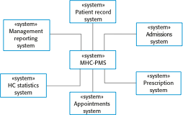
The context of the MHC-PMS

Slide 8
UML Activity Diagrams - behavior
Can be used to define high level business process or workflows
Shows how the system will be used at a high level
Order of activity made of many actions
Different from flowcharts - Support parallel behavior
Shows essential sequencing
Components
Actions box - (can be a basis for another activity diagram)
Process line
Fork line - one in and several out - multiple actions can start
Join line - close parallel actions - every action done by this line
Condition diamonds - decisions
Branch diamond - start conditional
Merge diamond - join back to the flow
Partition lines
Illustrate which system does what

Slide 9
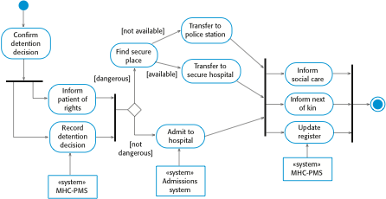
Process model of involuntary detention

Slide 10
Use case modeling - Interaction
Originally developed for requirements phase
Shows system boundary
Shows interactions with the outside world
Model discrete task - Set of scenarios with one goal
Actors (roles) may be people or other systems.
Diagram or Text
Start with the main success case
Write the other scenarios into the case as extensions
Can include other already defined use cases
Pre-condition / Guarantee at end / Trigger to start event
Keep steps simple and show who is involved in each step

Slide 11

Transfer-data use case
A use case in the MHC-PMS

Slide 12
Tabular description of the ‘Transfer data’ use-case
MHC-PMS: Transfer data
Actors | Medical receptionist, patient records system (PRS)
Description | A receptionist may transfer data from the MHC-PMS to a general patient record database that is maintained by a health authority. The information transferred may either be updated personal information (address, phone number, etc.) or a summary of the patient’s diagnosis and treatment.
Data | Patient’s personal information, treatment summary
Stimulus | User command issued by medical receptionist
Response | Confirmation that PRS has been updated
Comments | The receptionist must have appropriate security permissions to access the patient information and the PRS.

Slide 13
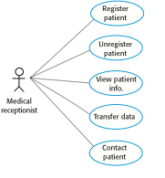
Use cases in the MHC-PMS involving the role ‘Medical Receptionist’

Slide 14
Sequence diagrams - Interaction
Sequence during a single scenario or use case
See behavior of several objects in one use case
Illustrate calls between participants and who is in charge of each step
Do not illustrate algorithms, loops, and conditions well
The objects and actors (participants) at the top
Dotted line drawn vertically (lifeline) from each participant
Rectangle over dotted line for activation of object
Interactions between objects -> annotated arrows
Data passing can be listed on arrows. Can put a participant name on an arrow
No need to determine how data is gathered, just that it is needed
Use a return arrow if you feel it will be helpful
Read Top to bottom; starting top left
Alt box - can handle conditions; conditions in [ ]

Slide 15
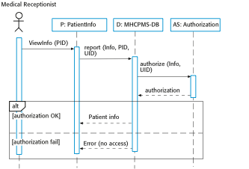
Sequence diagram for View patient information

Slide 16
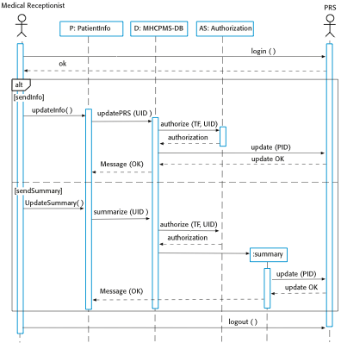
Sequence diagram for Transfer Data

Slide 17
Class diagrams - Structural
Class diagrams are used when developing an object-oriented system model to show the classes in a system and the associations between these classes.
An object class can be thought of as a general definition of one kind of system object.
An association is a link between classes that indicates that there is some relationship between these classes.
When you are developing models during the early stages of the software engineering process, objects represent something in the real world, such as a patient, a prescription, doctor, etc.

Slide 18
UML classes and association

Slide 19
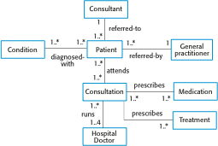
Classes and associations in the MHC-PMS

Slide 20

The Consultation class

Slide 21
Key points
Model definition - abstract view of a system that ignores system details. Types: system’s context, interactions, structure and behaviour.
Context models - position in the environment
Behavior - Activity diagram shows workflow
Interaction - users (including other systems) and your system
Use cases - who touches what
Sequence diagrams - messages sent back and forth in a sequence.
Structural - organization and architecture of a system.
Class diagrams - define the static structure of classes in a system and their association to other classes

Slide 22
Generalization
Generalization is an everyday technique that we use to manage complexity.
Rather than learn the detailed characteristics of every entity that we experience, we place these entities in more general classes (animals, cars, houses, etc.) and learn the characteristics of these classes.
This allows us to infer that different members of these classes have some common characteristics e.g. squirrels and rats are rodents.

Slide 23
Generalization
In modeling systems, it is often useful to examine the classes in a system to see if there is scope for generalization. If changes are proposed, then you do not have to look at all classes in the system to see if they are affected by the change.
In object-oriented languages, such as Java, generalization is implemented using the class inheritance mechanisms built into the language.
In a generalization, the attributes and operations associated with higher-level classes are also associated with the lower-level classes.
The lower-level classes are subclasses inherit the attributes and operations from their super classes. These lower-level classes then add more specific attributes and operations.

Slide 24
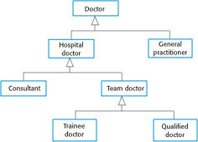
A generalization hierarchy

Slide 25
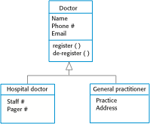
A generalization hierarchy with added detail

Slide 26
Object class aggregation models
An aggregation model shows how classes that are collections are composed of other classes.
Aggregation models are similar to the part-of / has –a relationship in semantic data models.
Use a diamond at the containing side
Fill the diamond if the part cannot exist without the whole

Slide 27

The aggregation association

Slide 28
Behavioral models
Behavioral models – how a system responds to stimulus
You can think of these stimuli as being of two types:
Data Some data arrives that has to be processed by the system.
Events Some event happens that triggers system processing. Events may have associated data, although this is not always the case.
Diagrams - Input through to output
Activity Diagram used on data
Data (object / box) and Action ( oval )
Sequence diagram
Data (top box ) and Actions (arrows)

Slide 29
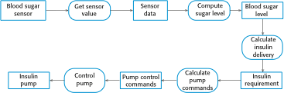
An activity model of the insulin pump’s operation

Slide 30
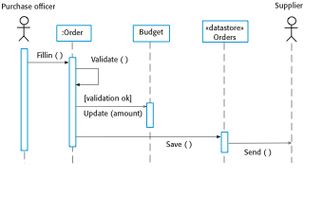
Order processing

Slide 31
Event-driven modeling
Real-time systems are often event-driven, with minimal data processing. For example, a landline phone switching system responds to events such as ‘receiver off hook’ by generating a dial tone.
Event-driven modeling shows how a system responds to external and internal events.
It is based on the assumption that a system has a finite number of states and that events (stimuli) may cause a transition from one state to another.

Slide 32
State machine models
These model the behaviour of the system in response to external and internal events.
They show the system’s responses to stimuli so are often used for modelling real-time systems.
State machine models show system states as nodes and events as arcs between these nodes. When an event occurs, the system moves from one state to another.
State charts are an integral part of the UML and are used to represent state machine models.

Slide 33
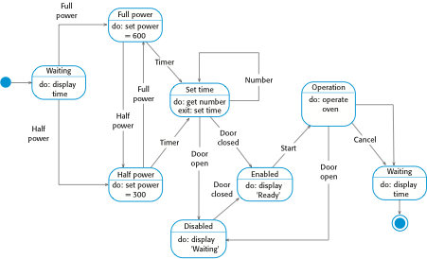
State diagram of a microwave oven

Slide 34
States and stimuli for the microwave oven (a)
State | Description
Waiting | The oven is waiting for input. The display shows the current time.
Half power | The oven power is set to 300 watts. The display shows ‘Half power’.
Full power | The oven power is set to 600 watts. The display shows ‘Full power’.
Set time | The cooking time is set to the user’s input value. The display shows the cooking time selected and is updated as the time is set.
Disabled | Oven operation is disabled for safety. Interior oven light is on. Display shows ‘Not ready’.
Enabled | Oven operation is enabled. Interior oven light is off. Display shows ‘Ready to cook’.
Operation | Oven in operation. Interior oven light is on. Display shows the timer countdown. On completion of cooking, the buzzer is sounded for five seconds. Oven light is on. Display shows ‘Cooking complete’ while buzzer is sounding.

Slide 35
States and stimuli for the microwave oven (b)
Stimulus | Description
Half power | The user has pressed the half-power button.
Full power | The user has pressed the full-power button.
Timer | The user has pressed one of the timer buttons.
Number | The user has pressed a numeric key.
Door open | The oven door switch is not closed.
Door closed | The oven door switch is closed.
Start | The user has pressed the Start button.
Cancel | The user has pressed the Cancel button.

Slide 36
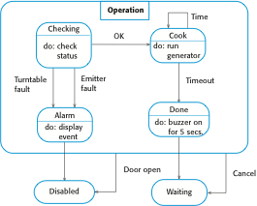
Microwave oven operation – use superstate

Slide 37
Usage of model-driven engineering
MDE
Raise level of abstraction in program spec
Increase automation in programming
Pros
Allows systems to be considered at higher levels of abstraction
Generating code automatically means that it is cheaper to adapt systems to new platforms.
Cons
Models for abstraction and not necessarily right for implementation.
Savings from generating code may be outweighed by the costs of developing translators for new platforms.

Slide 38
Model driven architecture (used by MDE)
MDA is a model-focused approach to software design and implementation that uses a subset of UML models to describe a system.
Models at different levels of abstraction are created. From a high-level, platform independent model, it is possible, in principle, to generate a working program without manual intervention.

Slide 39
Types of model
A computation independent model (CIM)
These model the important domain abstractions used in a system. CIMs are sometimes called domain models.
A platform independent model (PIM)
These model the operation of the system without reference to its implementation. The PIM is usually described using UML models that show the static system structure and how it responds to external and internal events.
Platform specific models (PSM)
These are transformations of the platform-independent model with a separate PSM for each application platform. In principle, there may be layers of PSM, with each layer adding some platform-specific detail.

Slide 40
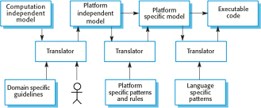
MDA transformations

Slide 41
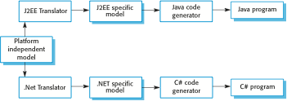
Multiple platform-specific models

Slide 42
Agile methods and MDA
The developers of MDA claim that it is intended to support an iterative approach to development and so can be used within agile methods.
The notion of extensive up-front modeling contradicts the fundamental ideas in the agile manifesto and I suspect that few agile developers feel comfortable with model-driven engineering.
If transformations can be completely automated and a complete program generated from a PIM, then, in principle, MDA could be used in an agile development process as no separate coding would be required.

Slide 43
Executable UML
The fundamental notion behind model-driven engineering is that completely automated transformation of models to code should be possible.
This is possible using a subset of UML 2, called Executable UML or xUML.

Slide 44
Features of executable UML
To create an executable subset of UML, the number of model types has therefore been dramatically reduced to these 3 key types:
Domain models that identify the principal concerns in a system. They are defined using UML class diagrams and include objects, attributes and associations.
Class models in which classes are defined, along with their attributes and operations.
State models in which a state diagram is associated with each class and is used to describe the life cycle of the class.
The dynamic behavior of the system may be specified declaratively using the object constraint language (OCL), or may be expressed using UML’s action language.

Slide 45
Learning Objectives
Understand the rules and style guidelines for sequence and communication diagrams and behavioral state machines.
Understand the processes used to create sequence and communication diagrams, behavioral state machines and CRUDE matrices.
Be able to create sequence and communication diagrams, behavioral state machines and CRUDE matrices.
Understand the relationship between the behavioral models and the structural and functional models.

Slide 46
Introduction
Behavioral models describe the internal behavior of a system
Behavioral model types:
Representations of the details of a business process identified by use-cases
Interaction diagrams (Sequence & Communication)
Shows how objects collaborate to provide the functionality defined in the use cases.
Representations of changes in the data
Behavioral state machines
Focus (for now) is on the dynamic view of the system, not on how it is implemented

Slide 47
Behavioral Models
Analysts view the problem as a set of use cases supported by a set of collaborating objects
Aids in organizing and defining the software
Behavioral models depict this view of the business processes:
How the objects interact and form a collaboration to support the use cases
An internal view of the business process described by a use case
Creating behavioral models is an iterative process which may induce changes in other models

Slide 48
Interaction Diagrams
Objects—an instantiation of a class
Patient is a class
Mary Wilson is an instantiation of the patient class (object)
Attributes—characteristics of a class
Patient class: name, address, phone, etc.
Operations—the behaviors of a class, or an action that an object can perform
Messages—information sent to objects to tell them to execute one of their behaviors
A function call from one object to another
Types
Sequence Diagrams—emphasize message sequence
Communication Diagrams—emphasize message flow

Slide 49
Sequence Diagrams
Illustrate the objects that participate in a single use-case
A dynamic model
Shows the sequence of messages that pass between objects
Aid in understanding real-time specifications and complex use-cases
Generic diagram shows all scenarios for a use-case
Instance diagrams show a single scenario

Slide 50
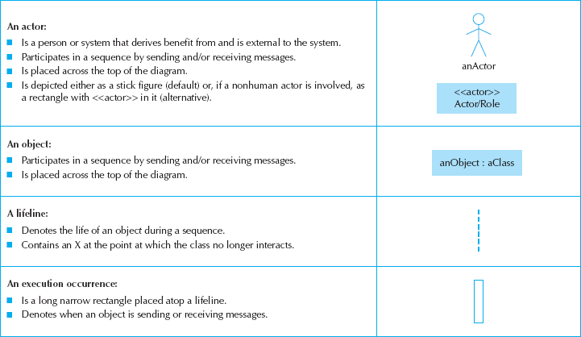
Sequence Diagram Syntax

Slide 51
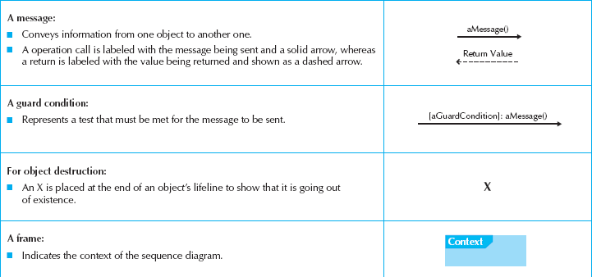
More Sequence Diagram Syntax

Slide 52
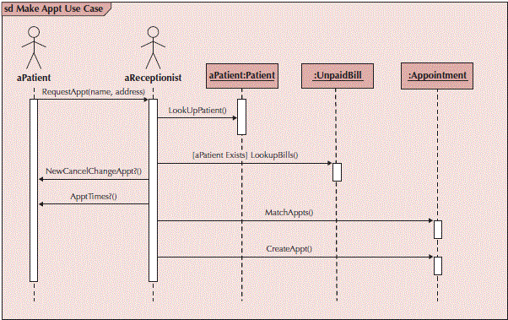
Sample Sequence Diagram

Slide 53
Guidelines for Creating Use-Case Diagrams
Order messages from left to right, top to bottom
Name actors and objects the same if they represent the same idea
Place the initiator of the scenario on the left of the diagram
Multiple objects of the same class: name each
Only show return values when they are not obvious
Justify messages near the arrowhead for improved readability

Slide 54
Building Sequence Diagrams
Set the context
Identify actors and objects that interact in the use- case scenario
Set the lifeline for each object
Add messages by drawing arrows
Shows how they are passed from one object to another
Include any parameters in parentheses
Obvious return values are excluded
Add execution occurrence to each object’s lifeline
Validate the sequence diagram
Ensures that it depicts all of the steps in the process

Slide 55
Communication Diagrams
Depict the dependencies among the objects
An object diagram that shows message passing relationships
Emphasize the flow through a set of objects

Slide 56
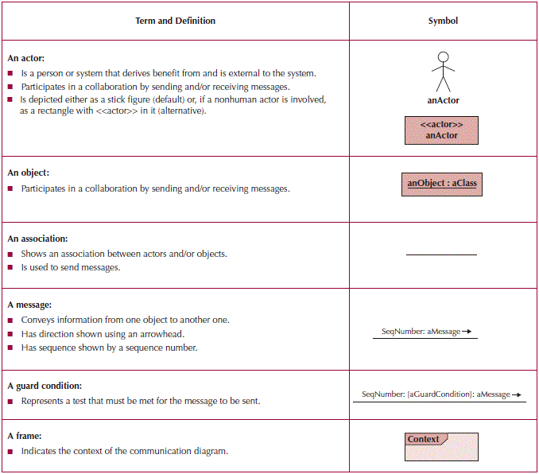
Communication Diagram Syntax

Slide 57
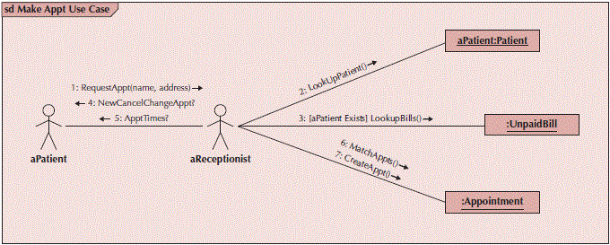
Sample Communication Diagram

Slide 58
Guidelines for Creating Communication Diagrams
Use the diagram to identify the objects involved in a use-case
Do not use a communication diagram to model process flow
Do not use a communication diagram to show message sequence

Slide 59
Building Communication Diagrams
Set the context
Identify objects, actors and associations between them
Lay out the diagram
Add the messages
Validate the model

Slide 60
Behavioral State Machines
Objects may change state in response to an event
Different states are captured in this model
Shows the different states through which a single object passes during its life
May include the object’s responses and actions
Example: patient states
New patient—has not yet been seen
Current patient—is now receiving treatment
Former patient—no longer being seen or treated
Typically used only for complex objects

Slide 61
Components of State Machines
States—values of an object’s attributes at a point in time
Events—the cause of the change in values of the object’s attributes
Transitions—movement of an object from one state to another
May include a guard condition to flag that a condition is true and allow the transition

Slide 62
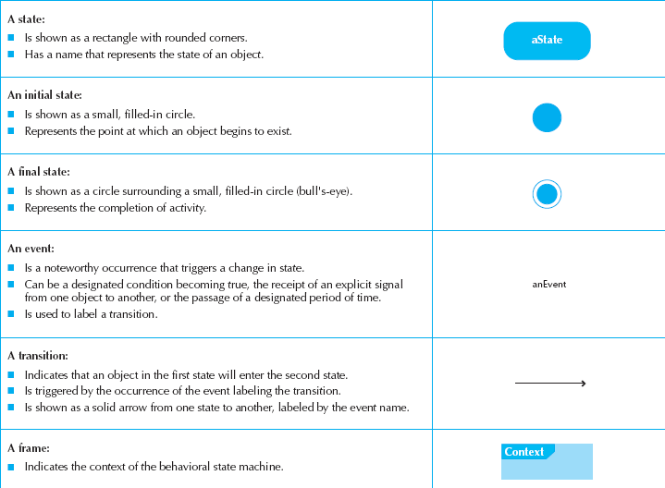
State Machine Syntax

Slide 63
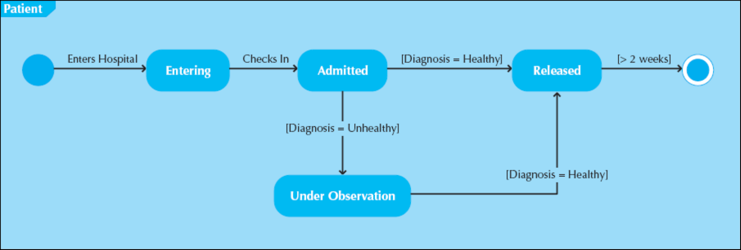
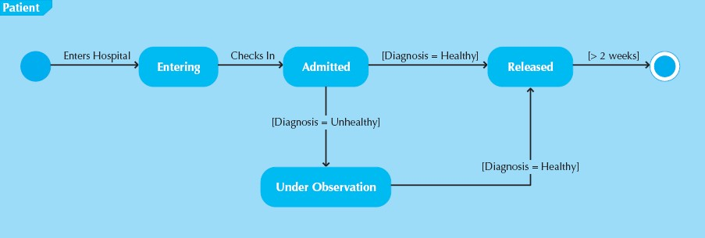
Sample State Machine

Slide 64
Guidelines for Creating Behavioral State Machines
Use only for complex objects
Draw the initial state in the upper left corner
Draw the final state in the bottom right corner
Use simple, but descriptive names for states
Look out for “black holes” and “miracles”
Ensure guard conditions are mutually exclusive
Ensure transitions are associated with messages and operations

Slide 65
Building a Behavioral State Machine
Set the context
Identify the states of the object
Initial
Final
Stable states during its lifetime
Lay out the diagram—use a left to right sequence
Add the transitions
Identify the triggers (events that cause the transition)
Identify the actions which execute
Identify the guard conditions
Validate the model—ensure all states are reachable

Slide 66
CRUDE Analysis
Helps to identify object collaborations
Labels object interaction in 5 possible ways:
Create—can one object create another?
Read—can one object read the attributes of another?
Update—can one object change values in another?
Delete—can one object delete another object?
Execute—can one object execute the operations of another?
Utilizes a matrix to represent objects and their interactions
Most useful as a system-wide representation

Slide 67
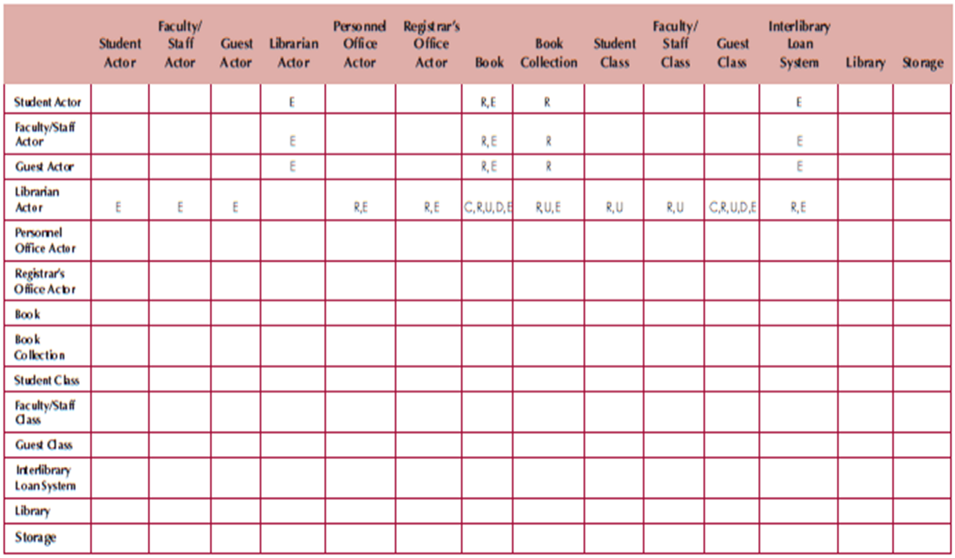
Sample CRUDE Matrix

Slide 68
Verifying & Validating Behavioral Models
Actors must be consistent between models
Messages on sequence diagrams must match associations on communication diagrams
Every message on a sequence diagram must appear on an association in a communication diagram
Guard conditions on a sequence diagram must appear on a communication diagram
Sequence of messages must correspond to the top down ordering of messages being sent
State transitions must be associated with a message on a sequence diagram
Entries in a CRUDE matrix imply messages being sent

Slide 69
Summary
Behavioral Models—provide a detailed view of how object collaborations support use-cases
Interaction Diagrams
Sequence diagrams
Communication diagrams
Behavioral State Machines—depicts the states of complex objects during its lifetime
CRUDE Analysis—helps to identify potential collaborations
Verifying & Validating behavioral models—ensures the completeness and consistency of the models

Slide 70
Key points
Behavioral models are used to describe the dynamic behavior of an executing system. This behavior can be modeled from the perspective of the data processed by the system, or by the events that stimulate responses from a system.
Activity diagrams may be used to model the processing of data, where each activity represents one process step.
State diagrams are used to model a system’s behavior in response to internal or external events.
Model-driven engineering is an approach to software development in which a system is represented as a set of models that can be automatically transformed to executable code.

